Slide 1
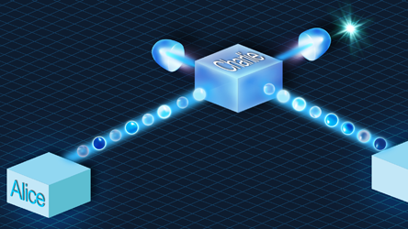
Update meeting 2
Joan, Juan & Timo

Slide 2
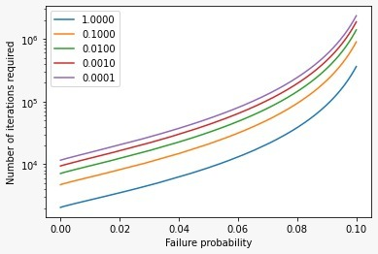
Privacy Amplification

Slide 3
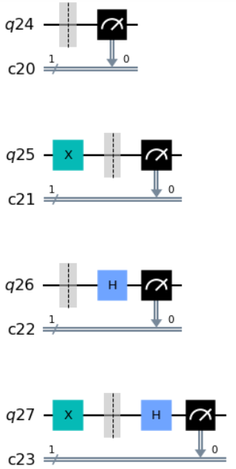
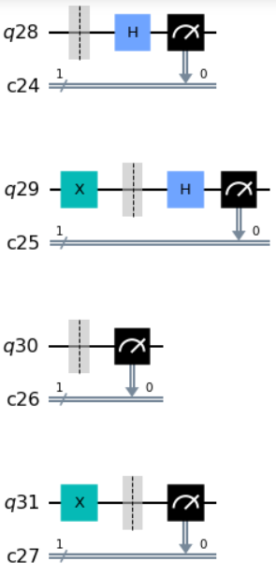
Basic BB84 Circuits

Slide 4
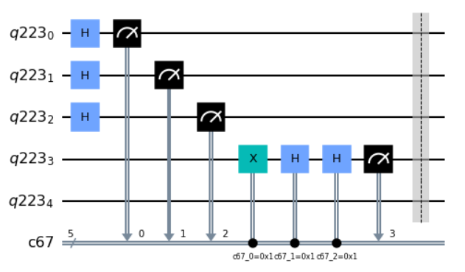


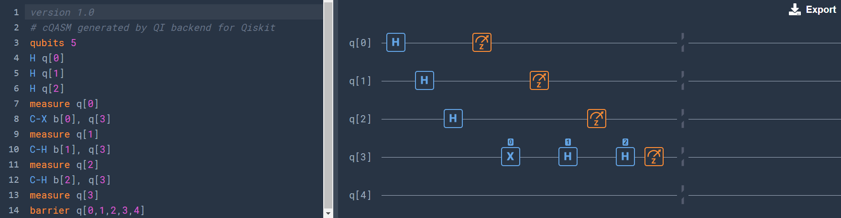

Slide 5
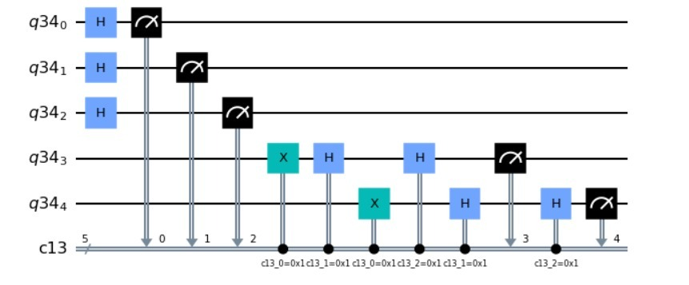
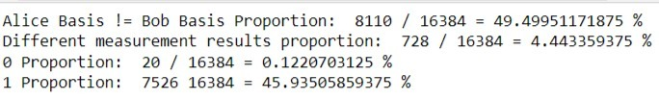
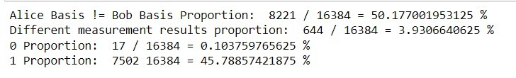
Conditional gates on Starmon-5?

Slide 6
Conditional gates on Starmon-5?

Slide 7
Overview
Done
Implement Quantum Randomness
To Do (this week)
Questions
Should we keep working on the conditional gates?
Juan: Privacy amplification + bit comparison theory
Joan: Eve implementation on Starmon-5
Timo: Make a clean version on Starmon-5
Individual Starmon-5 circuits analysis
What direction should the project go to? Should our focus move to implementing an actual version of BB84 or should we spend more time on classical methods to generate a key?

